Slide 1
Predicting Football Results Using Machine Learning Techniques

Slide 2
Introduction
"In football, predicting match outcomes accurately is crucial. Traditional methods have limitations, but with the advancement of machine learning, we can now predict results more effectively. Our project focuses on using machine learning to forecast football match scores and outcomes based on in-game events. Let's delve into how cutting-edge technology can revolutionize the way we analyze and predict football results."

Slide 3
Objectives
Our goals in this project
Predict Outcomes: Use machine learning to forecast match results accurately.
Improve Accuracy: Enhance the precision of predicting scores and match winners.
Explore Techniques: Investigate different machine learning methods for better predictions.
Optimize Models: Fine-tune algorithms to achieve the most reliable results.

Slide 4
Problem Statement:
Predicting football match outcomes accurately remains a challenge due to the complexity of factors influencing results. Traditional methods lack precision and fail to exploit the vast potential of machine learning techniques. Without reliable prediction models, fans and stakeholders face uncertainty and missed opportunities. The absence of accessible and accurate forecasting tools hampers decision-making processes for betting, fantasy leagues, and team strategies. To address these issues, there is a need to develop machine learning-based systems capable of analyzing diverse match-related data to predict outcomes with high accuracy, providing stakeholders with valuable insights and enhancing their engagement with the sport.

Slide 6
Methodology
"For our football result prediction project, we employed Support Vector Machines and Logistic Regression as our main tools. Support Vector Machines help us draw clear boundaries between different outcomes, while Logistic Regression aids in analyzing the probability of each result. By combining these two methods, we can make informed predictions about football match results based on the data we have.

Slide 7
Support Vector Machines provide a robust way to classify different possibilities, while Logistic Regression offers insights into the likelihood of each scenario Together, these techniques enhance the accuracy and effectiveness of our predictive models, allowing us to make more reliable forecasts about football match outcomes using advanced machine learning approaches."

Slide 8
Dataset
I am using two datasets for this project. The first dataset I got the data science community Kaggle. This dataset is used to perform exploratory data analysis. But this dataset has few missing data essential for prediction so the second dataset I am using is from. This dataset had more seasons and I am compiling these seasons into one and creating features to make prediction

Slide 9
This dataset was in SQLite format and has tables of Country, League, Match, Player, Player Attributes, Team ,Team Attributes and sequences. It has information of more than 25000 matches, 10000 players, 11 European Countries with their lead championship from 2008 to 2016, Players

Slide 10
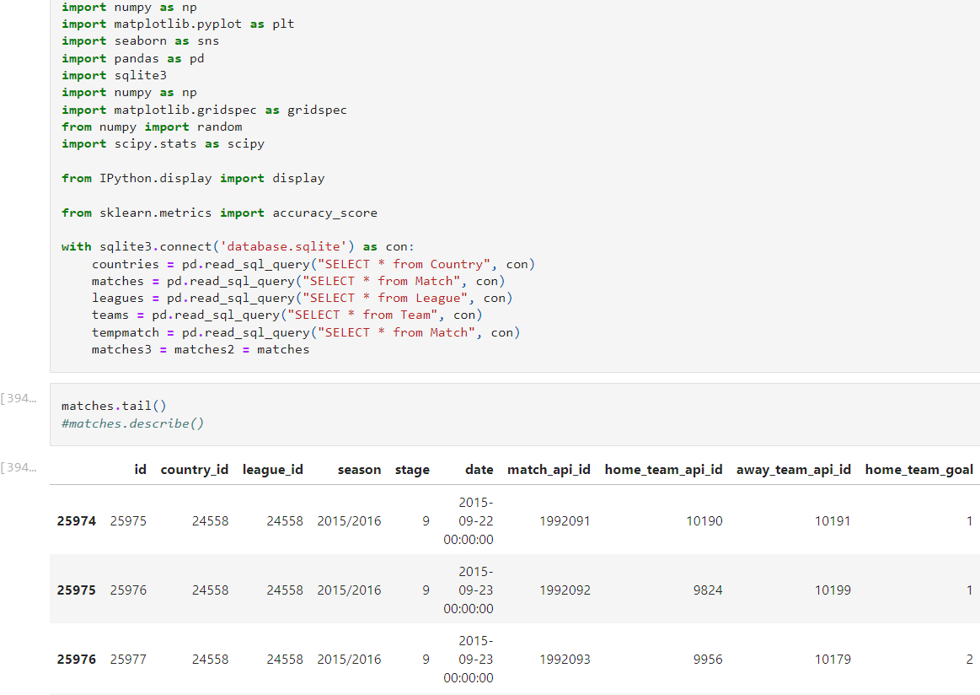

Slide 11
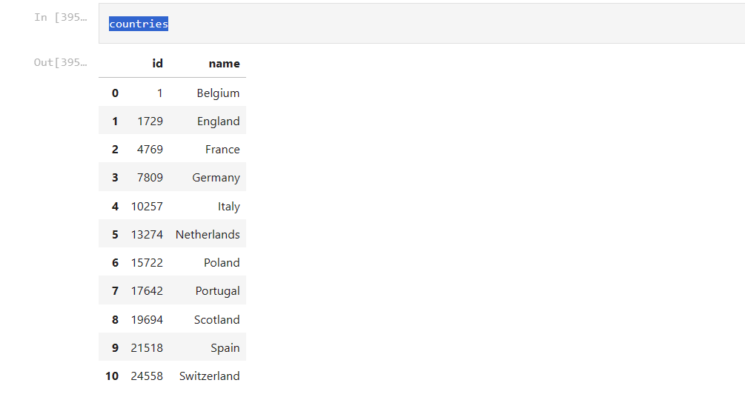
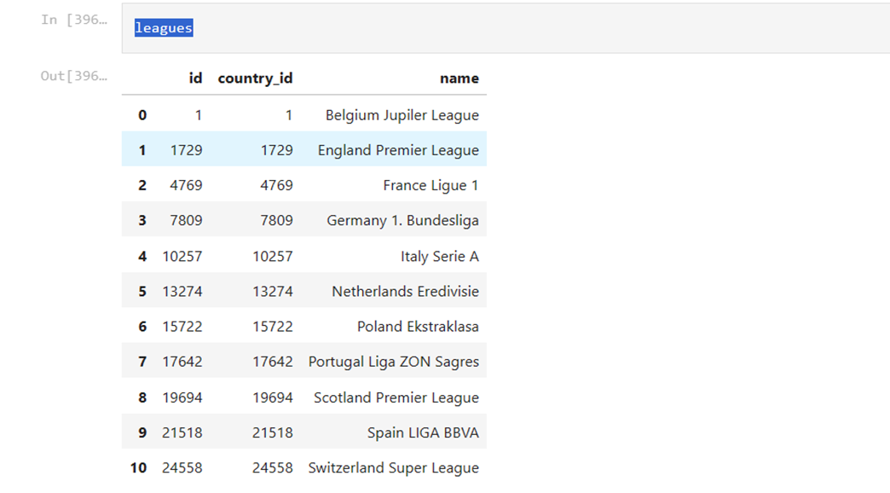
Countries Leagues

Slide 12

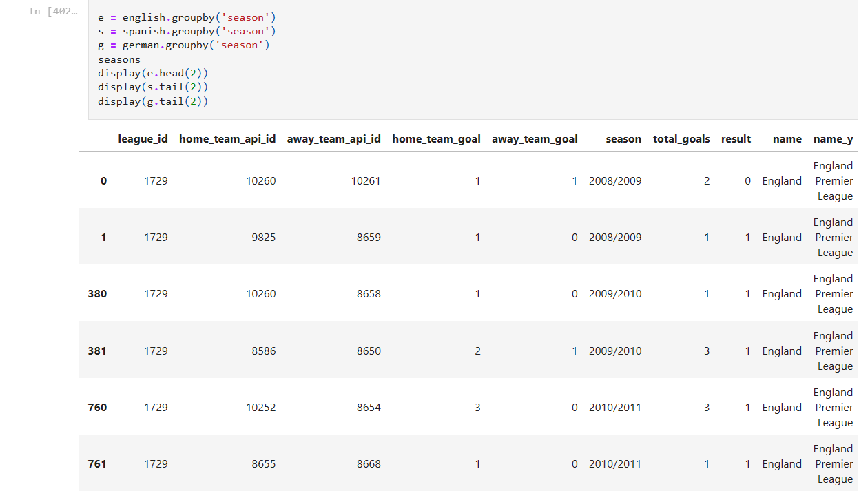
Selecting the countries of interest
Grouping and dividing by seasons
1. England

Slide 13
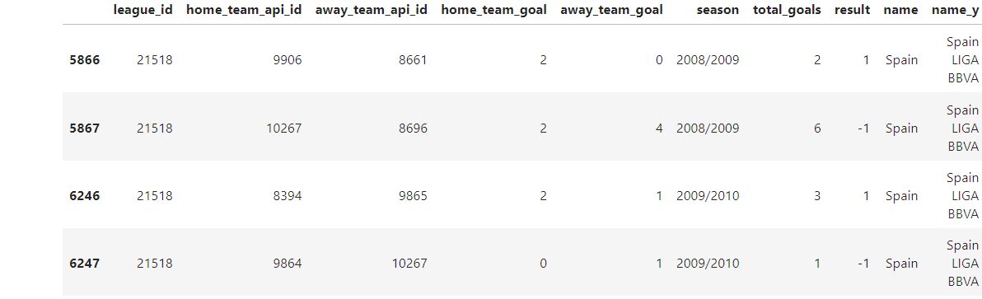
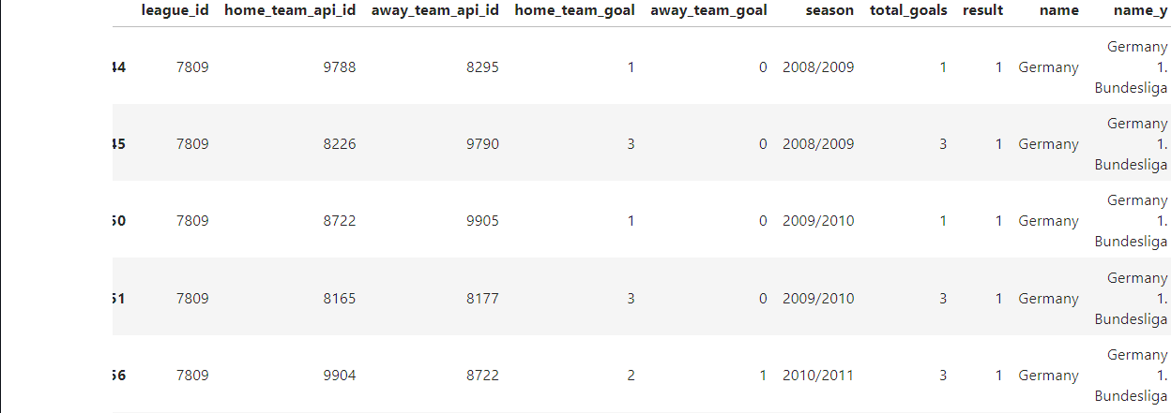
2.Spain
3.Germany

Slide 14
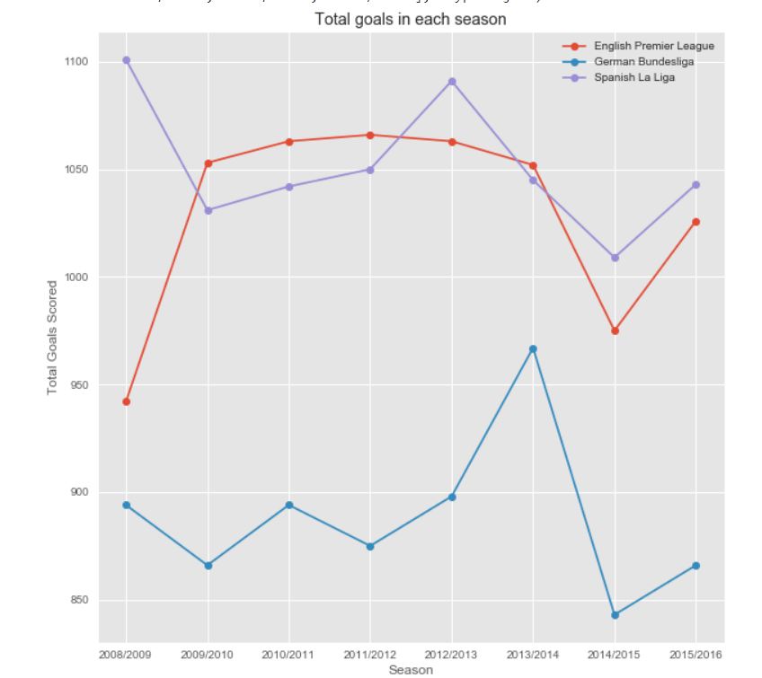
Plotting total goals scored each season

Slide 15
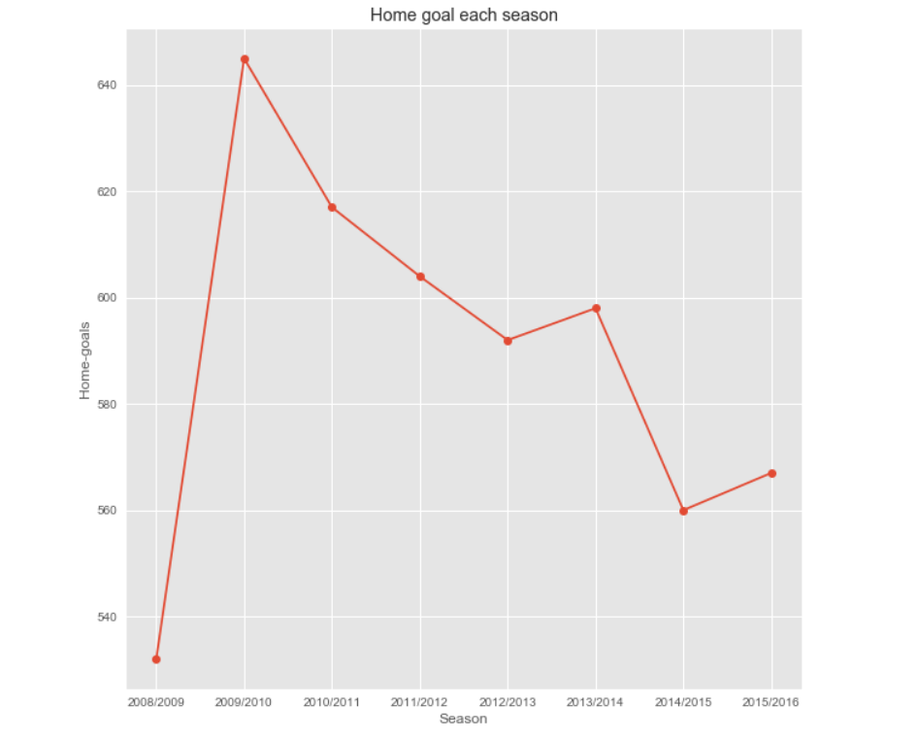
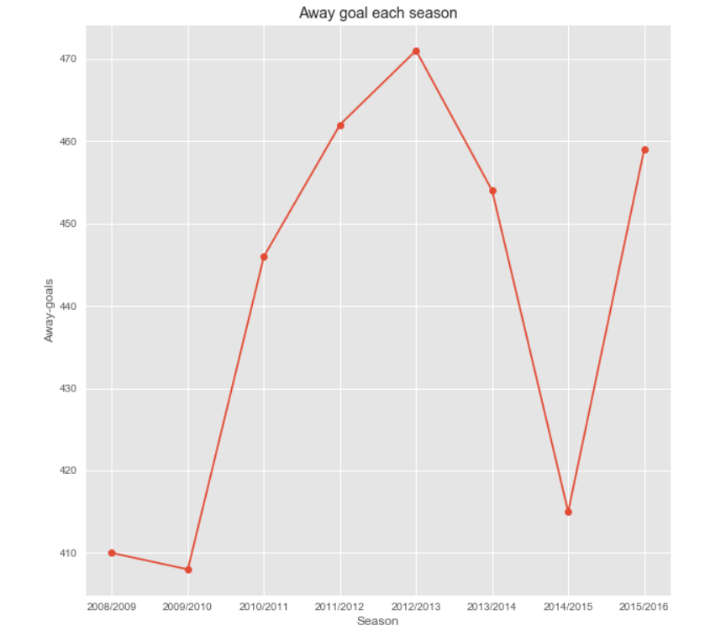
Getting total number of goals Total number of goals scored in Away matches scored in Home matches

Slide 16
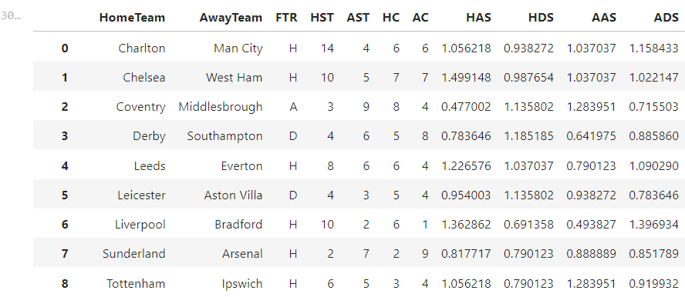
Home goals and Away goals
FTR - Full Time Result
HST - Home Shots on Target
AST - Away Shots on Target
HC - Home Team Corner
AC - Away Team Corner
HAS - Home Attacking Strength
HDS - Home Defensive Strength
AAS - Away Attacking Strength
ADS - Away Defensive Strength

Slide 17
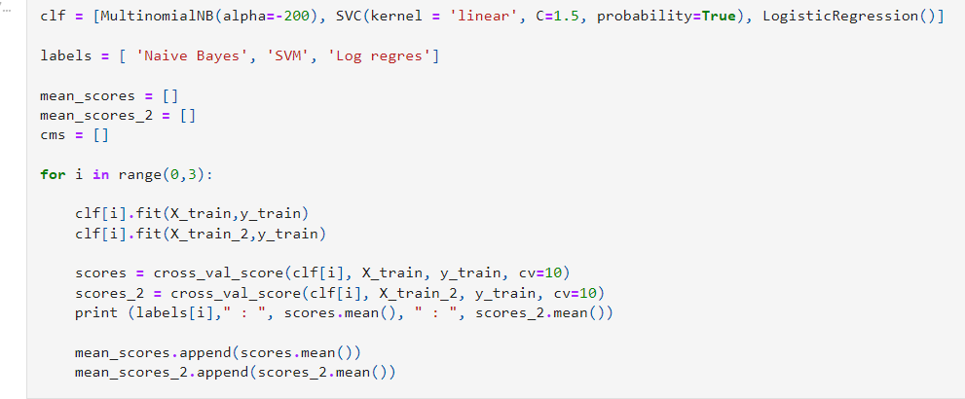
SVM : 0.539636080078 : 0.612009256973
Log regress : 0.554439825758 : 0.591447566859

Slide 18
Conclusion
Support Vector Machine gives the best accuracy score without normalization. But after normalization there was an improvement in the Logistic Regression output. The betting accuracy of bookies was around 53% while the model created using SVM gave an accuracy of 61.29%. The accuracy can further increase if we could add more features like team form or player form. We could also add the twitter analysis for prediction. We could implement different model like xgboost with the same features which could improve the accuracy.

